Slide 1
ENT201A Creativity & Innovation for Business
Topic 6: Open Innovation

Slide 2

Learning objectives
What is Open Innovation (OI)?
What are the drivers of open Innovation?
How does Open Innovation take place?
What are the pros and cons of open innovation?

Slide 3
Source: https://www.strategyzer.com/blog/open-innovation-results-going-beyond-the-hype-and-getting-down-to-business
Notes:
Source: https://www.strategyzer.com/blog/open-innovation-results-going-beyond-the-hype-and-getting-down-to-business

Slide 4

Overview: Open Innovation
Open innovation is a new innovation trend that many organisations are adopting all over the world. Open innovation is the practice of businesses and organisations sourcing ideas from external sources as well as internal ones. It is truly collaborative.
Notes:
https://www.ennomotive.com/open-innovation/

Slide 5
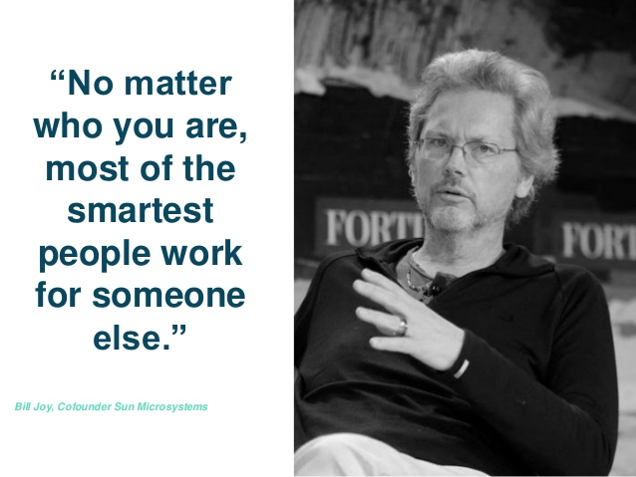
Some context…
Joy’s Law:
the notion that most of the knowledge critical to innovation often resides past the boundaries of an organisation
the central challenge for those charged with the innovation mission is to find ways to access that knowledge
Notes:
This is a statement known as Joy’s law in the high-tech industry, attributed to Sun Microsystems co-founder Bill Joy. Basically, this assumption emphasizes the knowledge problem faced by many enterprises today: in any given sphere of activity most of the pertinent knowledge will reside outside the company’s boundaries such as start-ups, inventors or academia, and the central challenge for those charged with the innovation mission is to find ways to access that knowledge. Joy’s law perfectly embodies the essence of Open Innovation as raising Innovation Management model for large corporate.

Slide 6

What is Open Innovation?
“Open innovation is the use of purposive inflows and outflows of knowledge to accelerate internal innovation, and expand the markets for external use of innovation, respectively.”
Chesbrough, Vanhaverbeke & West
Open Innovation: Researching a New Paradigm (2006)
“the father of open innovation”
Notes:
Open innovation has been defined as: the use of purposive inflows and outflows of knowledge to accelerate internal innovation, and expand the markets for external use of innovation, respectively (Chesbrough, 2003).
Dr. Henry Chesbrough is a co-founder of the Open Innovation Community and created the theory and coined the term "open Innovation." He is Executive Director of the Centre for Open Innovation at the Haas School of Business at the University of California, Berkeley, where he is also an adjunct professor.

Slide 7

What is open innovation?
“…a philosophy or a mindset that they should embrace within their organisation.
This mindset should enable their organisation to work with external input to the innovation process just as naturally as it does with internal input”

Slide 8
The Era of Open Innovation
Organisations are increasingly rethinking the fundamental ways in which they generate ideas and bring them to market
It’s all about harnessing external ideas while leveraging their in-house R&D outside their current operations
Organisations boundaries become ‘permeable’, enabling the matching and integration of resources between the company and external collaborators

Slide 9
Why is Open innovation important?
For business, open innovation is a more profitable way to innovate:
it can reduce costs (Cost savings: reduction of cost-to-market)
accelerate time to market (Time savings: reduction of time-to-market)
increase differentiation in the market (Novelty level: increase of the new-to-market)
create new revenue streams for the company
Source: https://www.forbes.com/sites/henrychesbrough/2011/03/21/everything-you-need-to-know-about-open-innovation/?sh=582c378175f4
Notes:
Source: https://www.forbes.com/sites/henrychesbrough/2011/03/21/everything-you-need-to-know-about-open-innovation/?sh=582c378175f4

Slide 10

Drivers of Open Innovation
Time savings: reduction of time-to-market
Cost savings: reduction of cost-to-market
Novelty level: increase of the new-to-market
Increasingly important due to:
Shorter life cycles
Increased market competition
Reductions in research and development budgets further promote open innovation
Division of labour reduces the development time of innovations and their cost
Perceived novelty of an innovation for the consumer
Involving users and other external innovation partners, open up new functionalities and create new markets

Slide 11
Drivers of Open Innovation
Risk minimisation: increase the fit-to-market
Linking of knowledge: Greater idea and knowledge base
Novelty level: increase of the new-to-market
High level of fit-to-market requires product or service offering that satisfies the needs of customers
Integrating innovative customers can:
increase market acceptance
significantly reduced the risk of undesirable developments
External and internal sources of ideas and knowledge can be tapped and used
Crowdsourcing is an excellent platform
Fiat Brazil developed a collaborative platform that combines crowdsourcing and open innovation to develop a "futuristic concept car" called Fiat Mio.
Perceived novelty of an innovation for the consumer
Involving users and other external innovation partners, open up new functionalities and create new markets
Notes:
Risk minimisation: increase of the fit-to-market
A prerequisite for a high level of fit-to-market (market acceptance of a new product) is a product or service offering that satisfies the needs of customers. By integrating innovative customers/clients/guests into the open innovation process, market acceptance can be significantly increased and the risk of undesirable developments reduced.
Linking of knowledge: Greater idea and knowledge base
Through open innovation, numerous external and internal sources of ideas and knowledge can be tapped and used to take innovation management to a new level. Around one hundred R&D projects are required to place twelve successful innovations on the market. The number of ideas needed to start 100 projects is much higher. Innovation therefore requires many ideas: The best way to have a good idea is to have lots of ideas. In addition to the integration of external innovation partners and own employees into the innovation process, Internet-based Open Innovation Communities are becoming increasingly important. The creativity of the Internet community is used to find ideas for innovative products, new distribution channels, new business fields and business models. The type of cooperation ranges from the submission of ideas to the community's evaluation of the ideas on the platform to the further development of the ideas by the community. For example, the Italian car manufacturer Fiat used the creative ideas of the community to develop the Fiat 500 before it was launched on the market. 170,000 proposals submitted show just how much interest there is in such participation processes. Further examples of crowdsourcing platforms are: ÖBB Open Innovation Platform, Unilever, InnoCentive, atizo, Quirky, Open Innovation Platform of the Federal Government.

Slide 12
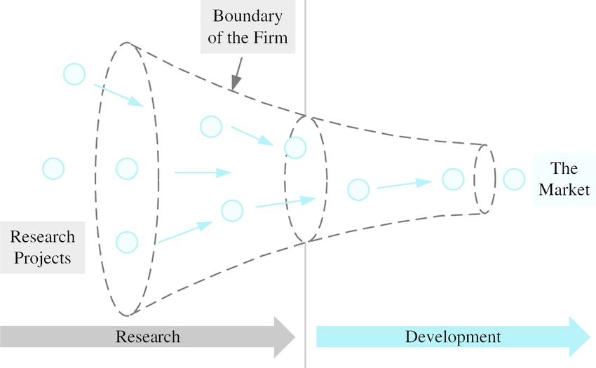
Model of Closed Innovation
Source: https://www.researchgate.net/figure/Schematic-diagram-of-closed-innovation-model-Adapted-from-Open-Innovation-by-cf-Blum_fig1_268420341
Notes:
The Closed Innovation Model
In closed innovation, a company generates, develops and commercializes its own ideas. This philosophy of self-reliance dominated the R&D operations of many leading industrial corporations for most of the 20th century.
They invested more heavily in internal R&D than their competitors and they hired the best and the brightest (to reap the rewards of the industry’s smartest people).
Hire bright people
Put them in special conditions
Free from market pressures
Pipeline of ideas to products
Delivered to passive waiting consumers

Slide 13
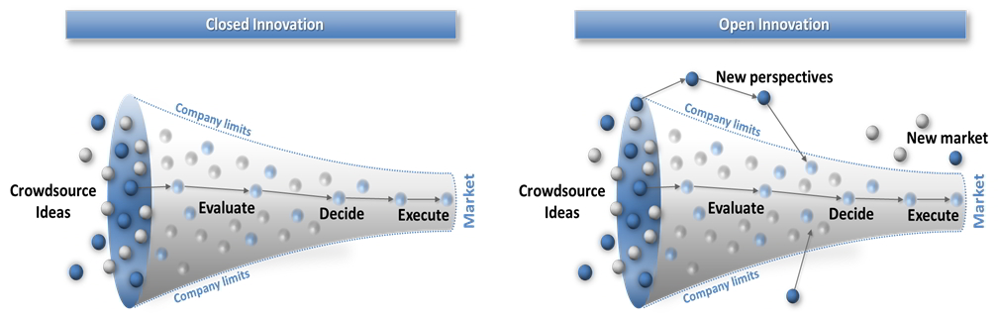
Closed vs Open Innovation
Source: http://cspinnovate.com/methodology/
Notes:
Closed Innovation: Assumptions
Knowledge is created, codified, sent and received
Authors of inventions can define their use
Intellectual property should be protected to create incentives
Consumption is passive - a yes/no choice
Innovation comes from within, self-reflective process
Closed Innovation: Applications
The R & D Lab: Thomas J Watson, Bell Labs
Specialist creative activities in companies
Professional disciplines of architecture and design
Elite university education
The Pipeline view of the world

Slide 14
Closed innovation
Open innovation
Other firm´s market
Licence, spin out, divest
Our new market
Internal technology base
Internal/external venture handling
Our current market
External technology insourcing
External technology base
Stolen with pride from Prof Henry Chesbrough UC Berkeley, Open Innovation: Renewing Growth from Industrial R&D, 10th Annual Innovation Convergence, Minneapolis Sept 27, 2004
Notes:
Open Innovation: Generation
Multiplying sources of ideas
Technology costs down
Combining ideas in networks easier
Skilled labour more mobile, independent
Outsourcing: distribution of labour leading to distribution of knowledge
End of knowledge monopolies
Open Innovation: Propagation
Consumers are innovators
Radical innovations: the users work out what innovation is for
Disruptive innovation: passionate users innovate, producers follow
New markets and business models start in marginal markets
Service innovation requires users to rewrite scripts
Leisure economy: Pro-Am users and serious leisure

Slide 15
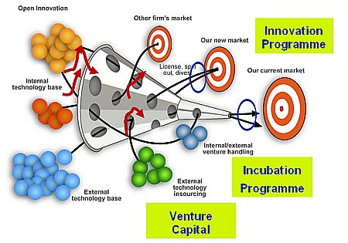
Open Innovation
Source: https://ipacso.eu/innovation-modelling/theorectical-models-ans-methodologies/open-innovation.html
Notes:
Alternate slide to previous slide #14

Slide 16

Drivers of Open Innovation
According to Chesbrough:
Other factors:
Socio-economic changes in the workforce
Globalisation
New technologies
Emergence of market institutions which enable trade in ideas
Faster pace, shrinking window of opportunity, less time for cash cows
Driven by global megatrends: faster, more open, more transparent and more connected
Dramatic rise in the number and mobility of knowledge workers
making it difficult for companies to control their proprietary ideas and expertise
Things are changing fast and we need a more holistic approach to innovation!

Slide 17

The Division of Innovation Labor
Open Innovation separates innovation into multiple stages
From a marathon to a relay race
Lab and Test Equipment are Fundamental to this division of labor
Customer’s ability to verify that spec was met
Supplier’s confidence that good product was delivered
Enables the innovation baton to be passed efficiently and effectively

Slide 18
Open and Closed Innovation: The Future?
Continued reform of the closed model: networked, platform innovators
Closed innovators learning from open model
Wider application of the open model from software
Hybrid mixes of the open and closed models

Slide 19
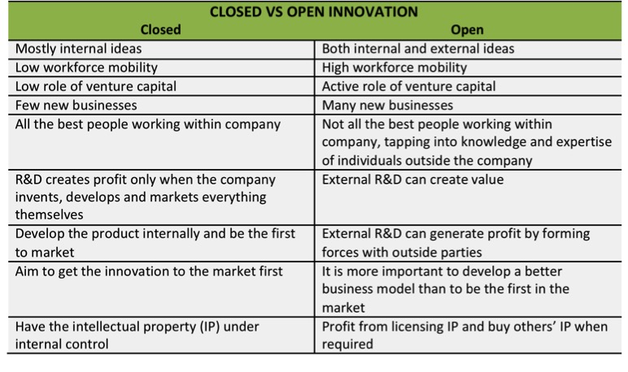
Closed vs Open Innovation
Source: http://science-union.org/articlelist/2016/10/6/what-is-open-innovation

Slide 20


Activity: Types of Open Innovation (OI)
Working in groups, research the two (2) types of OI:
Tournament based OI
Collaboration based OI
Briefly define each and provide examples to support your groups findings to the class
For inspiration, you may visit:
InnoCentive- a global pioneer in crowdsourced innovation
Fiat Mio - The world's first collaborative car
Discuss in small groups (Zoom Break-out rooms)
20 minutes
De-brief/discussion in main session
Notes:
The aim of this Activity is to promote initial discussion on the content and process of an open innovation strategy; Namely to review the two (2) types of OI:
Tournament based OI
Collaboration based OI
Subjects:
Collaborative innovation, Crowdsourcing, Open innovation

Slide 21
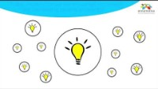

Video: Open Innovation: Accelerating Your Business Results
An Open innovation model for innovation that promotes collaboration with people and organizations outside the company.
This model is a true cultural break from the company silo mentality and the secrecy traditionally associated with the corporate R&D culture.
Open innovation becomes viable when the company acknowledges that there are many bright professionals and greater knowledge outside the organisation.
https://www.youtube.com/watch?v=n_vgcxG0y88&feature=youtu.be
Note: You may wish to use the link above and adjust the PLAYBACK speed to 0.75 to ensure enough time to read the information.

Slide 22
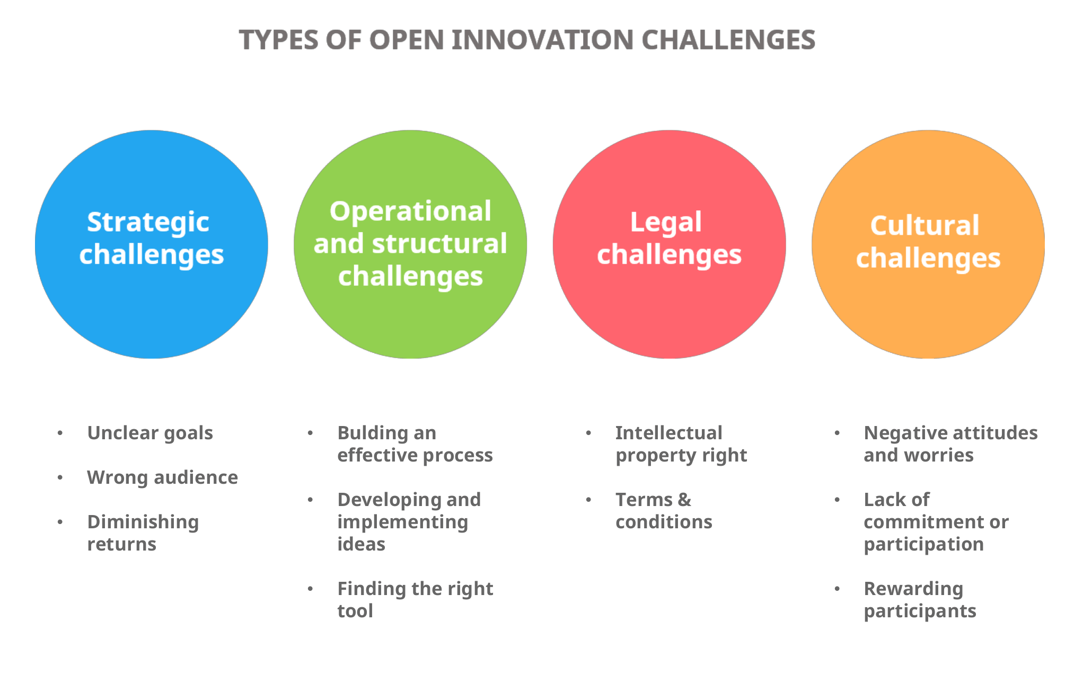
Open Innovation Challenges
Source: https://www.viima.com/blog/open-innovation-challenges

Slide 23
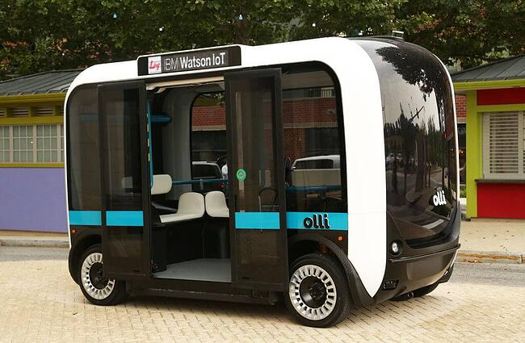


Video: LITECAR Challenge
https://youtu.be/9CWwzTcwDQY
While vehicle powertrains have become more efficient and powerful over time, the issue of high curb vehicle weight still exists. That’s what the LITECAR Challenge is here to change.
Local Motors Co-Creation products, Olli, the self-driving smart bus
LITECAR Challenge: http://localmotors.com/litecar
Source: https://www.viima.com/blog/16-examples-of-open-innovation-what-can-we-learn-from-them

Slide 24


Video: Crowdsourcing & Open Innovation
The Laboratory of Innovation Science at Harvard is currently working on a number of studies, experiments, and projects that centre around Crowdsourcing & Open Innovation.
Such initiatives allow for the optimization of research for solutions to complex problems by calling on the crowd, instead of limiting knowledge to what is available within an organisation.
https://www.youtube.com/watch?v=QLIOdQSQ74o&feature=emb_logo

Slide 25
Open innovation challenges: Strategic
Diminishing Returns
Ideally, engaging external partners to collaborate with your R&D will maximise your returns in the beginning of the project with low cost
Source: https://www.viima.com/blog/open-innovation-challenges

Slide 26
Open Innovation Challenges: Operational and Structural
To building an effective process, the most common challenges are lack of goals, unclear communication, lack of stakeholder support, immeasurability and lack of strategy alignment
Most companies face challenges especially with:
Prioritising ideas - How do we decide which ideas are worth proceeding with?
Team capacity - Who is going to be responsible for the progress of the ideas?
Resources - Are there enough resources and how to allocate them?
Other ideas- What are we going to do with all of the other ideas that are good but cannot yet be implemented?
Source: https://www.viima.com/blog/open-innovation-challenges

Slide 27

Open Innovation Challenges: Operational and Structural
The real challenge is how to find the right open innovation platform as there are several great options available
Ideally, an open innovation tool is:
Engaging
Easy-to-use
Transparent
Flexible
Adaptable
Customisable
Source: https://www.viima.com/blog/open-innovation-challenges
Notes:
Platforms: https://www.viima.com/blog/16-examples-of-open-innovation-what-can-we-learn-from-them

Slide 28
https://youtu.be/csMUGmZ0KqI
Notes:
Other platforms https://crowdsourcingweek.com/blog/10-indispensable-open-innovation-platforms-global-corporations/

Slide 29
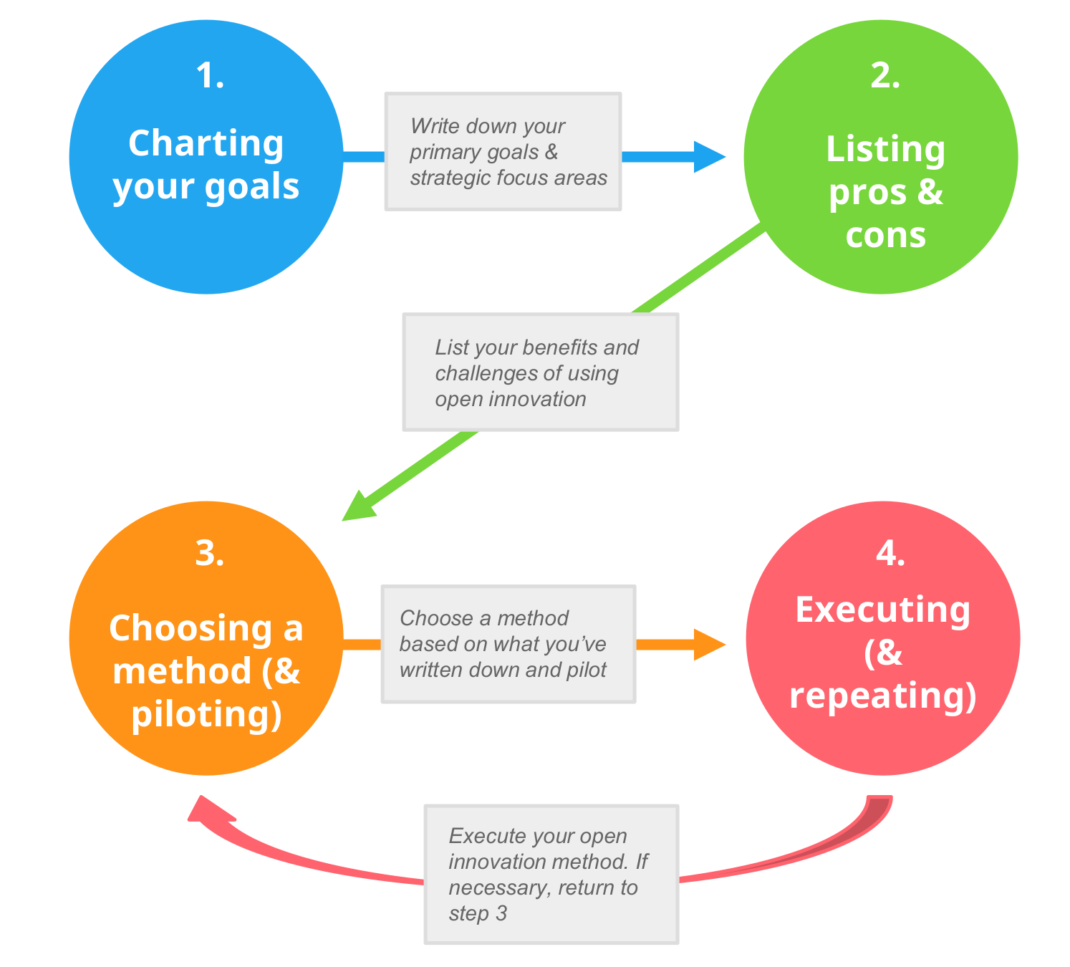
Activity: Open Innovation Methods
Open Innovation (or idea) Challenge
Crowdsourcing
Open Idea Ecosystem
Open innovation lab
Colleague Crowd
Research and answer:
What it is and How to use; When? Why?
Discuss in small groups (Zoom Break-out rooms)
20 minutes
De-brief/discussion in main session
Source: https://www.viima.com/blog/open-innovation

Slide 30
Open Innovation Process
Source: https://www.viima.com/blog/open-innovation-challenges

Slide 31
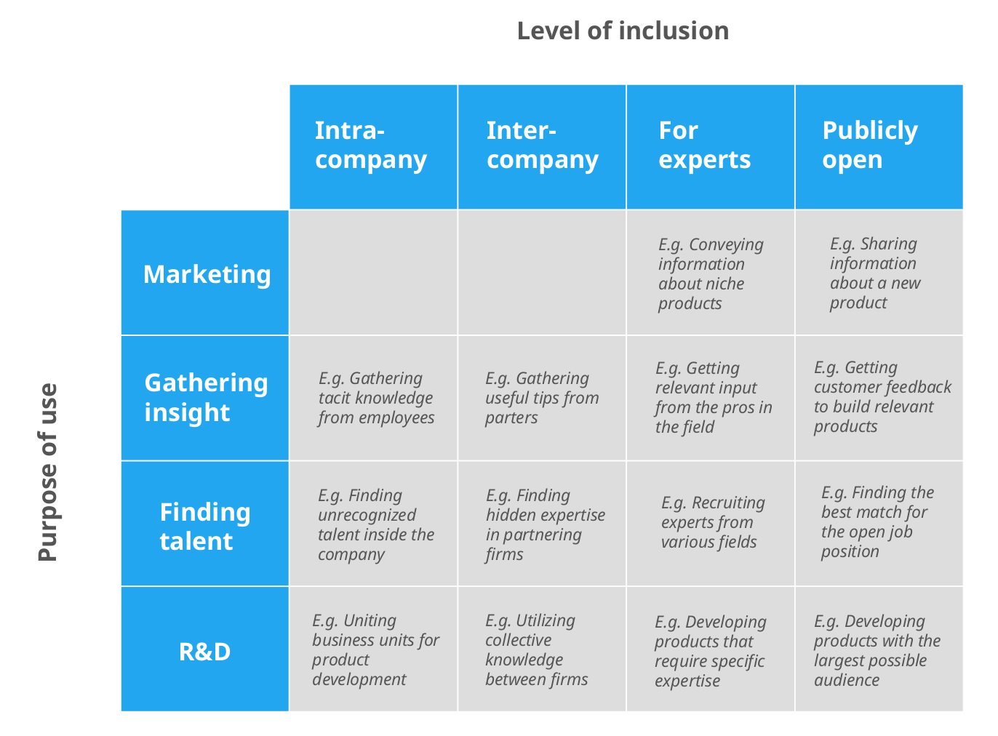
Source: https://www.viima.com/blog/open-innovation-challenges
Notes:
Check examples in the website

Slide 32
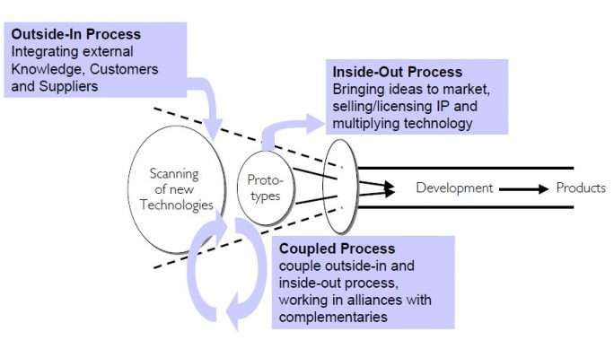
Types of Open Innovation
Outside-in process (ideas brought from outside in order to complement internal R&D)
Inside-out process (commercialisation of surplus internally developed ideas or technologies)
The coupled process (combination of outside-in and inside-out)
Figure Outside-in, inside-out and coupled open innovation process Source: Gassman & Enkel, 2004

Slide 33
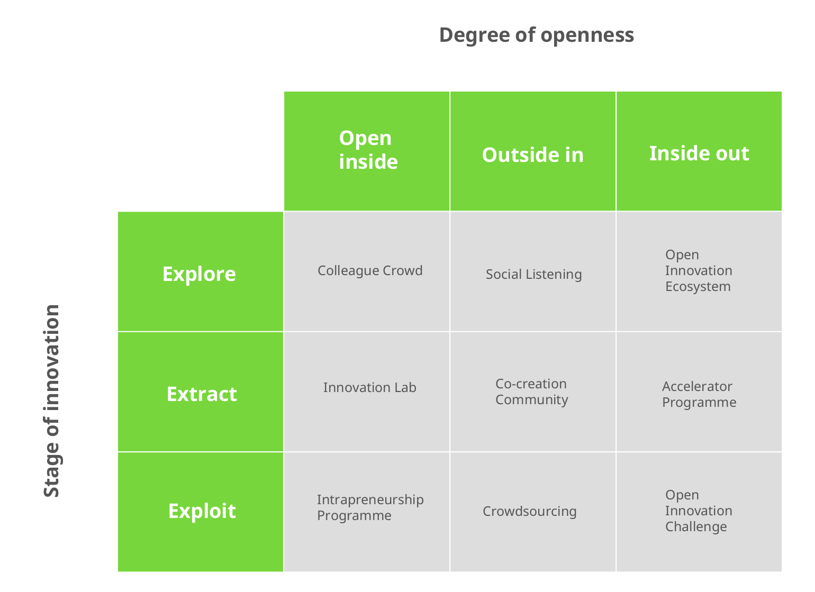
Types of Innovation
Source: https://www.viima.com/blog/open-innovation-challenges

Slide 34
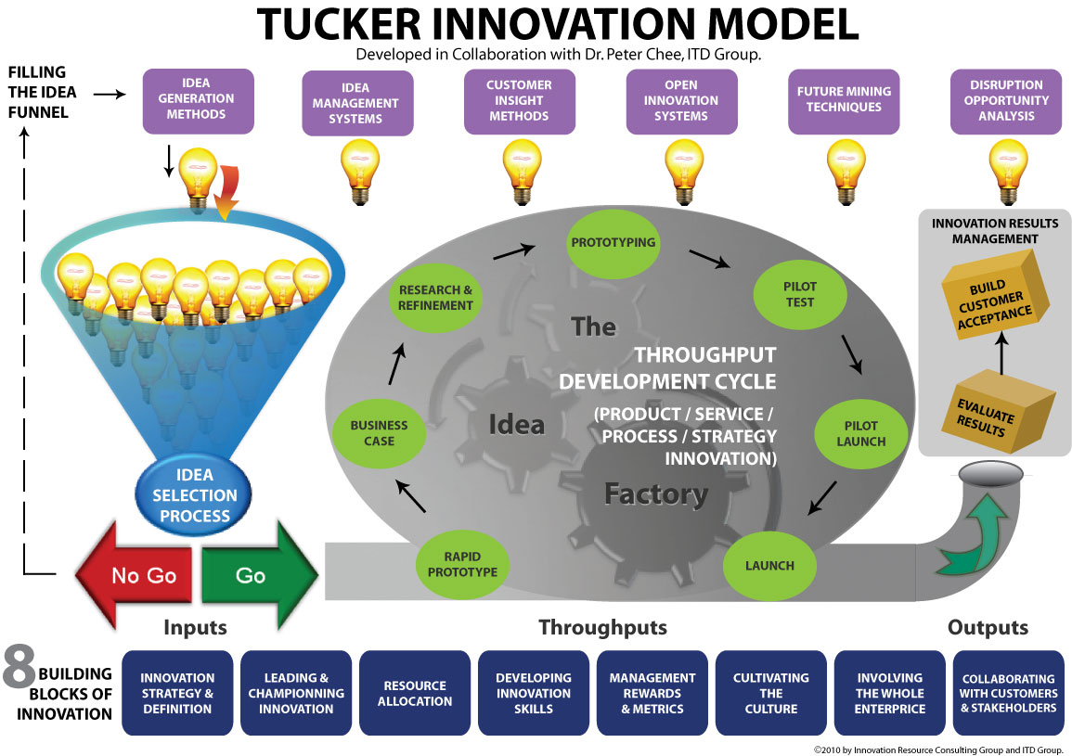
Source: https://www.innovationresource.com/tucker-innovation-model/

Slide 35
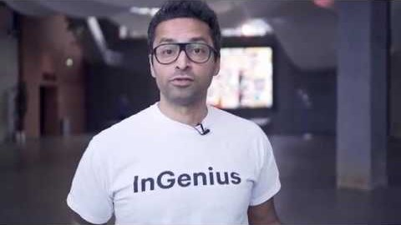

Video: Nestlé InGenius Annual Review (2017)
A short review of the main achievements of InGenius, Nestlé's employee-drive innovation accelerator.
In 2017, InGenius reached the mark of 40,000 employees in its platform, with people coming from 51 different markets.
Our community shared more than 700 ideas, which led to 14 new innovations to bring new competitive advantages to Nestlé.
https://www.youtube.com/watch?v=sBVve7kSif8&feature=youtu.be
https://ingenius-accelerator.nestle.com/

Slide 36

Benefits of open innovation
Engaging larger audiences
Engaging relevant audiences
Improving Cost efficiency
Involve customers in R&D
Chance for lucrative partnerships
Finding new talent
https://www.viima.com/blog/open-innovation

Slide 37
Barriers to Open Innovation
Intellectual property rights and how this interaction can be managed within established organisations
Such particular organisational demands are placed on the management of innovation by the Open Innovation paradigm itself (Arnold, 2008)
Insufficient expertise of one partner
Possibility of information leaks regarding valuable technologies, especially in collaborations with competitors

Slide 38
Popular Open innovation models
Government driven
Idea competitions
Customer immersion
Innovation networks
Innovation intermediaries

Slide 39
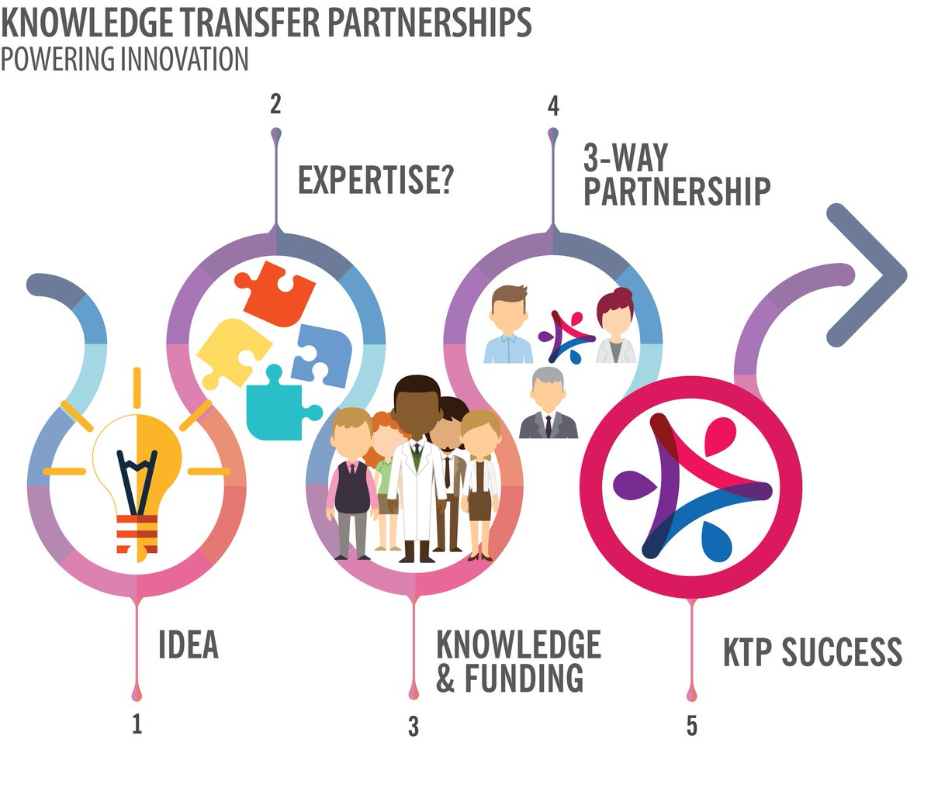
Government driven
Some countries form knowledge transfer partnerships (KTP) as a funding mechanism encouraging the partnership between a firm and a knowledge-based partner
A KTP is a collaboration program between:
a knowledge-based partner (i.e. a research institution)
a company partner and
one or more associates (i.e. recently qualified persons such as graduates)

Slide 40
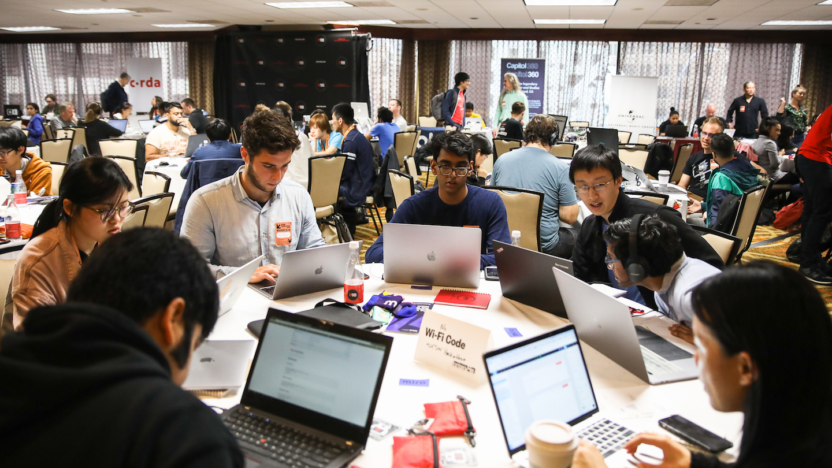
Idea competitions
This model entails implementing a system that encourages competitiveness among contributors by rewarding successful submissions
Developer competitions such as hackathon (FB) events fall under this category of open innovation

Slide 41

Customer immersion
This technique involves extensive customer interaction through employees of the host organisation
Companies are able to:
accurately incorporate customer input
allow them to be more closely involved in the design process and product management cycle

Slide 42

Innovation intermediaries
Innovation intermediaries are persons or organisations that facilitate innovation by linking multiple independent players in order to encourage collaboration and open innovation
It strengthens the innovation capacity of companies, industries, regions, or nations
Innovation intermediaries, broadly defined as “organisations that provide a supportive role for collaboration between two or more parties during various stages of the innovation process” (Howells, 2006)

Slide 43


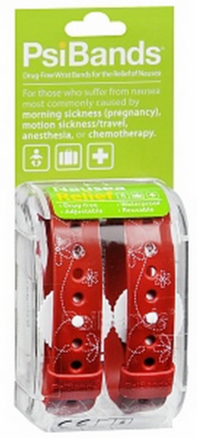

SUCCESSFULL CASES
Example:
Apply Now for the Huggies MomInspired Grant Program
Who: Mompreneurs - 21 and older - with an original, innovative and viable new product idea to help make life easier for parents; must reside in the United States
How: Log onto www.HuggiesMomInspired.com and submit application including the idea and business plan
When: April 25, 2012 through July 31, 2012
Why: For the chance to receive $15,000 and advice to help make business dreams a reality

Slide 44


SUCCESSFULL CASES

Slide 45



SUCCESSFULL CASES
GE Link Bulb

Slide 46

Key Points:
An organisations innovation performance progresses with acceptance of novel concepts from its surroundings
Compromise exists between the paybacks of open innovation and the profits of internally-generated innovation
Uncertainties connected with the use of open innovation; yet, not using open innovation may be even more uncertain for the future of an organisation in a rapidly changing environment

Slide 47
Key Points:
Open Innovation is a compliment & not a replacement for in-house R&D
There are different times and places for the different types of Open Innovation
Impact versus speed
Getting it right requires striking a balance between
Culture
Tools
Processes

Slide 48

Questions

Slide 49

References
Reed,R.,Storrud-Barnes,S.andJessup,L.,(2012), “Howopeninnovationaffectsthedriversofcompetitiveadvantage:TradingthebenefitsofIPcreationandownershipforfreeinvention”, ManagementDecision,50(1),pp.58-73.

Slide 50


The next steps
You should now:
Download week 6 resources and complete post class activities to reinforce this weeks learning
Please consult Moodle for any class announcements this week
Review The FORUM and participate by commenting on topics
See you online

Slide 51

End of Session

Slide 52


END of session
Thank you for listening
Good Luck with your studies!
See you next week

